Slide 1
Infrastructure SDK done right
Our journey with Pulumi
"We do not do it because it's easy.
We do it because we thought it would be easy."
Pavel Vařenka
Senior DevOps Engineer
@Mews

Slide 2
The coming of Terraform
The esoteric, distant past of IaC tools
Endless battle between Dev and Ops
What‘s up with the fragmented ecosystem?
The new kid on the block
One persistent problem…
Notes:
No need to be too verbose about the IaC topic – all of you are probably familiar with the term
In the old days, people used to manage infrastructure with tools only strong specialists could understand, such as Chef, Puppet or Ansible (usually in tandem)
It wasn‘t simple, but it was working… Except that it widened the rift between Dev and Ops
A lot of these early tools were procedural/imperative rather than declarative. Usually in a proprietary, new language (or worse… YAML)
Thankfully, in 2014 a new kid on the block helped save the day - Terraform
„Cloud-native“ by default, Terraform providers supported most of major clouds and simplified the process of deploying anything, anywhere
It introduced a new, unified declarative language – HashiCorp Language (HCL)
As adoption grew and got easier, so did the management – running TF in pipelines, managing state via Terraform Cloud,…
The trend was clear, a new industry standard was born and lasted for years
There was just one caveat – it quite didn‘t solve the „DevOps problem“

Slide 3
A new rival - Pulumi
Bold approach to an age-old discrepancy
Declarative Imperatives
Back to the basics
From Ops to DevOps – transferrable skills
Notes:
Over the years, the industry shifted and there was a need for something more developer-centric
In the end, the potential solution to Ops x Dev discrepancy presented itself – speaking the same language as developers
Pulumi took the best concepts of Terraform, and came with a bang – multi-language ability
Now, Ops and developers finally found an intersection, writing both the product and infrastructure in the same imperative, general-purpose programming language
No more HCL or proprietary new languages/DSLs that take time to master
Terraform knowledge was transferable, as both are remote state-first and use the same or similar schema of providers.

Slide 4
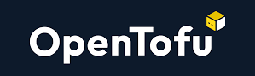
From early adopters to lagging adoption
Is Terraform done for? OpenTofu revival
Merging two separate worlds
Enough buzzwords – let‘s dive in!
Notes:
Pulumi nowadays offers similar features to Terraform (Pulumi Cloud for easy insights, ESC for secrets management, Policy-as-Code, Packages as modules,…)
Adoption is still lagging behind, but that could change due to HashiCorp‘s licensing change - MPL v2 to BSL v1
The landscape is changing from separate, declarative infra configuration to having infra baked in with the product
The rise of Platform Engineering is speeding up this process (Internal Developer Platforms, treating infrastructure code as internal product)
INTRODUCE OPENTOFU

Slide 6
&
First experiments and the need for scale and reproducibility
Separation from monolith – the Atlas framework
Treating infrastructure as internal product
Above and beyond – automation & infrastructure SDK
Notes:
Mews started experimenting with Pulumi a few years ago as one of early adopters
The reason for IaC was pretty simple – number of Azure resources grew, ClickOps doesn‘t work at scale
We needed to accomodate the infrastructure needs of our monolith application, as well as new, smaller services (Atlas)
The end goal was to combine the best of both worlds – declarative and imperative – by creating an abstraction over Pulumi
This wrapper came to be known as our internal Infrastructure SDK – a library that anyone can use, especially in Atlas (separate services outside of the monolith repository)
Instead of letting devs handle the complexity, we provide reusable building blocks with some constraints
Pulumi preview on PRs
GHA vs. Octopus

Slide 7
&
Why did we choose Pulumi over Terraform?
Reaping benefits from Pulumi Cloud
What the hell is Infrastructure SDK?
Do you regret it?
Notes:
Why did we choose Pulumi over Terraform?
Predominantly C# development -> much more freedom
Devs started taking care of infrastructure (Tooling and Platform Engineering)
Ease of use, treating the infra the same way we treat of product (versioning, package publishing,…)
Why Pulumi Cloud?
Easier management and insights
Completely managed state and backend
Straightforward onboarding, a lot of useful features around automation
Why Infrastructure SDK?
Easier to implement and abstract „golden paths“ and best practices
Full control over implementation while giving developers option to declare infra themselves and use what they need
Everything is baked in using regular imperative approach, but the public interface is straightforward and declarative
Building platform rather than infrastructure
„Shared responsibility“ model
Do you regret it?
We‘ll get to that later :)

Slide 8
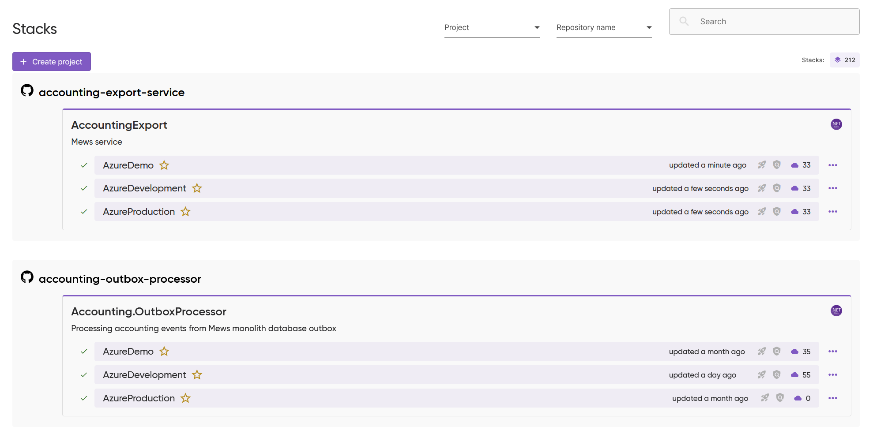

Slide 9
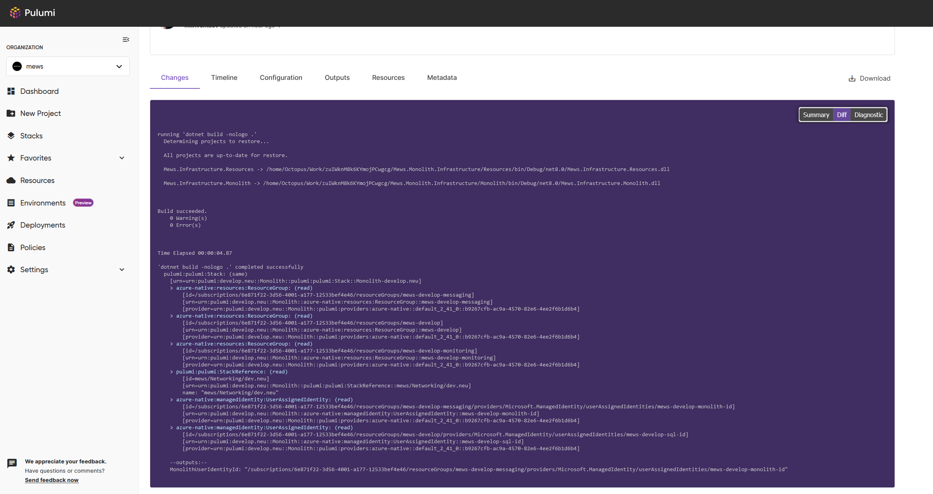

Slide 10
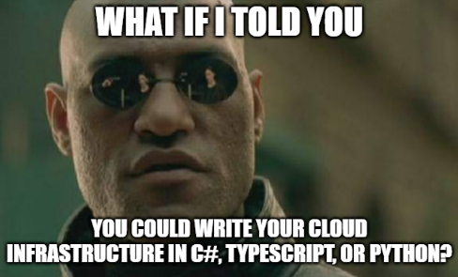

Slide 11
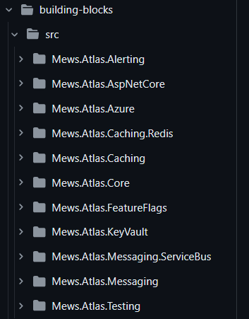
Infrastructure SDK
Unification and baking in best practices – building blocks
One pattern to rule them all
Untangling a tangled mess
The ebb and flow of shared ownership
Notes:
We slowly started moving away from monolith – or rather complementing it with smaller, additional services
To ease adoption, we came up with building blocks – reusable libraries with observability, security and best practices baked in
This helped us establish a framework that all new services follow – Atlas
We wanted to follow a similar pattern with our infrastructure SDK – everything written in C#, easily imported in a project, declarative
We strived to separate how we currently manage monolith infra and infra related to new services
Ownership – monolith x Atlas

Slide 12
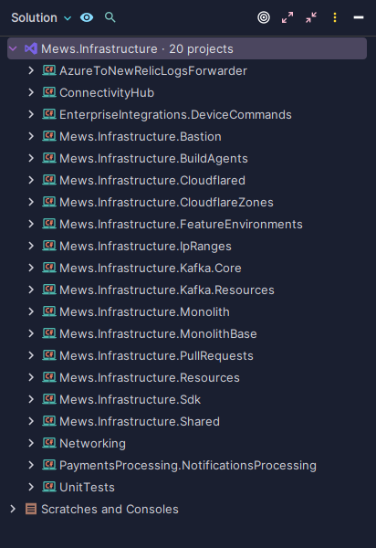
Infrastructure SDK
Monorepo as a gateway to our infrastructure
Monolith x SDK management
Abstractions everywhere
Choose CI/CD tools wisely
Notes:
We have one big mews-infrastructure monorepo where we define classes with reusable methods to create common Azure resources
These methods are later used to prepare resources in individual Pulumi stacks related to our monolith application, these are managed by us internally
The repository also contains our entire SDK that strictly specifies things like naming conventions, multi-region deployments, environment configuration and more
We simply wrap our own methods and classes around Pulumi‘s, imagine TF modules in terms of end-user simplicity
Due to having everything in one place, we can easily split CI/CD actions based on path (releasing a new NuGet package vs. running Pulumi up)
Other stacks?

Slide 13
Monolith stack

Slide 14
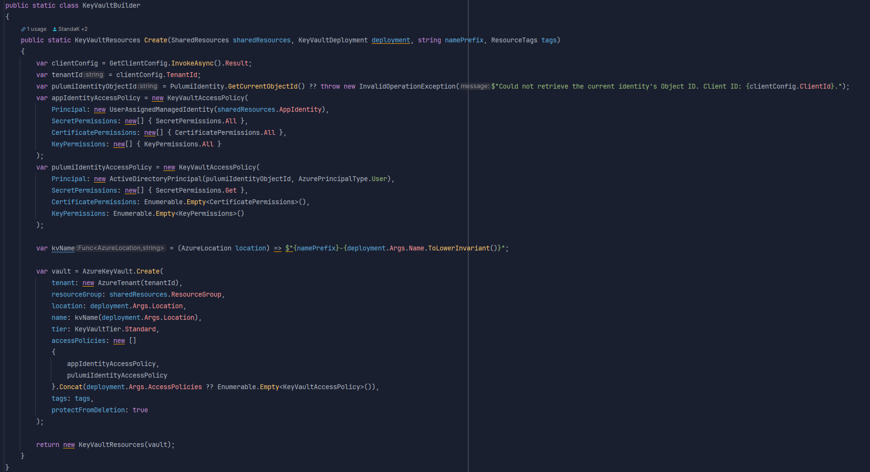
Infrastructure SDK

Slide 15
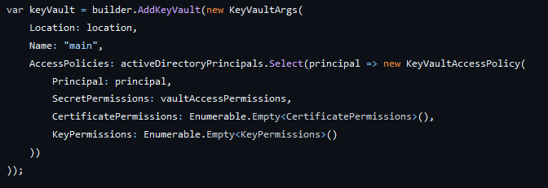
Infrastructure SDK

Slide 16
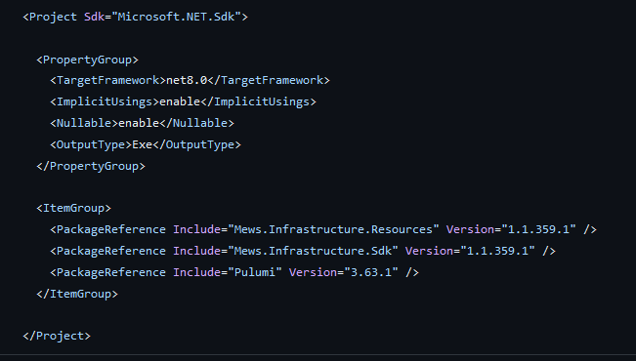
Publishing NuGet packages
We use GHA to distribute the NuGet packages
We simply push the packages to our Azure DevOps registry
These are later on referenced by our Atlas adopters in their own project
This way, we can keep track of versioning and release management
Notes:
We use GHA to distribute the NuGet packages
If the path of changed resources happens to be in the SDK directory, we simply push the packages to our Azure DevOps registry
These are later on referenced by our Atlas adopters in their own project
This way, we can keep track of versioning and release management
Atlas adopters can easily bump the version
GHA and Octopus, more tools (messy)

Slide 17
Much easier adoption, shared responsibility model for infrastructure
Platform Engineering more aligned with developers
Structured approach to building an internal platform
Much more freedom in how we write IaC
Notes:
The good
Much easier adoption, shared responsibility model for infrastructure
Platform Engineering more aligned with developers
Structured approach to building an internal platform
Much more freedom in how we write IaC

Slide 18
Harder iteration and testing compared to a DSL
Very easy to write spaghetti code and drift from best practices
Proprietary – can‘t easily compare whether we are headed in a right direction
Hard to document all edge cases
Notes:
The bad
Harder iteration and testing compared to a DSL
Very easy to write spaghetti code and drift from best practices
Proprietary – can‘t easily compare whether we are headed in a right direction
Hard to document all edge cases

Slide 19
Difficult to onboard new people
Massive growth in complexity
Quite rigid and opinionated
Growing tech debt
Notes:
The ugly
Difficult to onboard new people (C#, abstractions, quite large codebase)
Massive growth in complexity
In some ways rigid/opinionated and fragile – hard to keep backwards compatibility while delivering new features
Growing tech debt

Slide 20
Recap!
Overall, our approach is very different. Is it hard and unconventional at times? Yes. But we are still proud of it. :-)
Notes:
So… do we regret it?
Lessons learned – ease down on the abstractions and complexity, too many moving parst (consolidation), clean up more often
Still unclear ownership sometimes
Working on refactoring and tech debt
Issues with finding the right people for the job
Where do we want to go next?
Changing the mindset
Less burden on Platform Engineering team

Slide 21
Thank you!

